Slide 1
Functions of Genes differentially expressed in cancers highly associated with Type 2 Diabetes
Kameryn McCarty
April 15, 2014
IBS574

Slide 2
Diabetes and Cancer
More often diagnosed in the same person than would be expected by chance
Share many risk factors: Age, sex, obesity, physical activity, diet, etc.
Diabetics at greatly elevated risk for cancers of liver, pancreas, and endometrium
Associated with many other cancers to a lesser extent
Notes:
Flies fed a high sugar diet developed more tumors through a feed forward loop involving Wnt signaling, insulin receptors, and insulin signaling.
Approximately 24 different cancers have some increased risk associated with diabetes. To date, lung cancer has not been associated and prostate cancer is less common is diabetic men.
Some biological pathways that are disrupted in diabetics are inflammation, (which diabetics generally have chronic inflammation in their cells), glucose metabolism and insulin signaling as a result of insulin resistance or hyperglycemia.

Slide 3
My Question
Do cancers highly associated with diabetes show differential expression of genes enriched for functions or pathways dysregulated in diabetic patients?
Notes:
I was interested in investigating the biological reason these cancers are so much more common in people with diabetes than other cancers

Slide 4
The TCGA Cancer Datasets
Cancer Type | Abbreviation | T2D associated risk? | Tumor samples | Normal samples
Liver hepatocellular carcinoma | LIHC | Yes | 147 | 50
Lung adenocarcinoma | LUAD | No | 490 | 58
Prostate adenocarcinoma | PRAD | No | 278 | 50
Uterine corpus endometrial carcinoma | UCEC | Yes | 370 | 11
*Also downloaded pancreatic adenocarcinoma data, but the set did not have enough normal samples to have power to detect differences in expression
Notes:
I originally planned to investigate five cancers, three associated and two non-associated, but the pancreatic data set did not have enough normal samples.

Slide 5
Using edgeR to find DE genes between normal and tumor tissue samples
>x <- read.delim("cancer_rnaseqv2.txt", header=TRUE, sep="\t", row.names=1) >group <- factor(c(1,2,2,1,2,1,…))
>y <- DGEList(counts=x, group=group)
>y <- estimateCommonDisp(y)
>y <- estimateTagwiseDisp(y)
>et <- exactTest(y)
>re <- topTags(et, n=length(et))
Notes:
This is an example of the R code I used to run the edgeR analysis on my cancer data sets, which is gene-based rather than transcript-based. I read in my table of counts which I downloaded from the Cancer Genome Atlas. Next I used a python script to assign each sample to a group, either normal or tumor, and then put this information into R in the object “group”. I used the edgeR DGEList function and estimated the common and tagwise dispersions of the data (edgeR uses a negative binomial distribution in it’s Differential gene expression analysis ). Then I did a Fisher’s exact test for each gene in the list of 20531 genes to calculate statistics. Finally I returned all of the genes to a new object where the genes were ranked by p-value (although it returned fold change, counts per million, and False discovery rate as well).

Slide 6
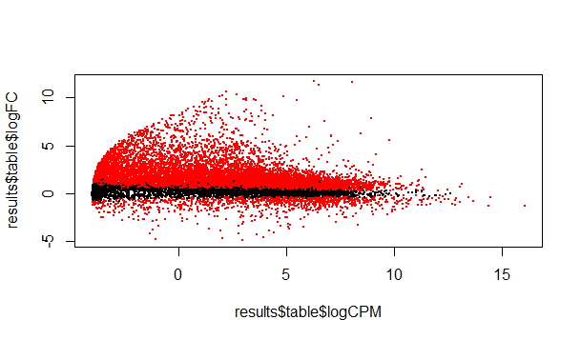
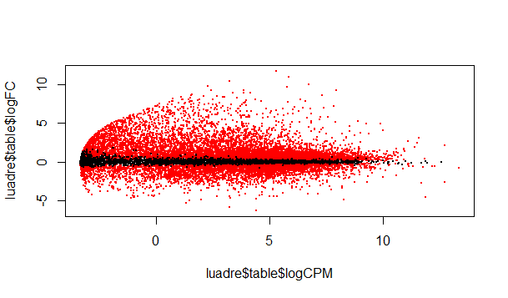
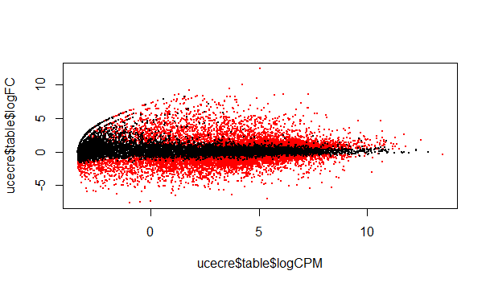
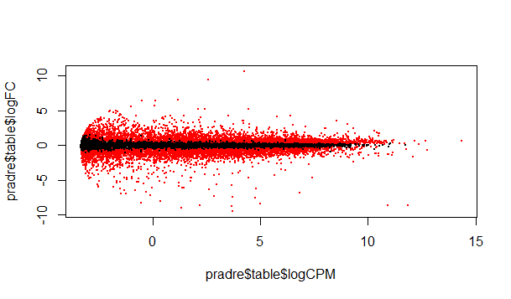
There were many differentially expressed genes in each cancer type
Liver
Lung
logFC
logFC
logCPM
logCPM
Uterine
Prostate
logFC
logFC
logCPM
logCPM
Notes:
These are plots of log fold change against log of read counts per million to visually inspect the data…they show the distribution of Differentially expressed genes for each cancer if a false discovery rate of 0.1 (or 10%) was used—red dots are the significantly DE genes and black is nonsignificant. For my analyses, I actually used a more conservative Bonferroni correction value for my cutoff for significantly differentially expressed. If I had included the pancreatic cancer, almost all of the dots would have been black.

Slide 7
Differentially Expressed Genes identified by edgeR
Cancer Type | Abbrev. | Number of Genes tested | DE Genes
Liver hepatocellular carcinoma | LIHC | 20531 | 10887
Lung adenocarcinoma | LUAD | 20531 | 9556
Prostate adenocarcinoma | PRAD | 20531 | 5447
Uterine corpus endometrial carcinoma | UCEC | 20531 | 3179
DE p-value cutoff -> Bonferroni Correction: 0.05/20531 = 2.44e-06
Notes:
So I found thousands of differentially expressed genes in each cancer type even using my conservative Bonferroni corrected cutoff. Next I wanted to figure out which of the DE genes were common to which cancers. I was most interested in those genes that were commonly differentially expressed the risk cancers and not in the non-risk cancers. To do that I used R logic vectors to classify my genes and made a two by two matrix.

Slide 8
Fisher’s Exact test for significance
 | Non-assoc. cancer DE genes
T2D-assoc. cancer DE genes |  | TRUE | FALSE
 | TRUE | 700 | 1182
 | FALSE | 2556 | 16093
Fisher's Exact Test for Count Data
data: Fisher_table
p-value < 2.2e-16
alternative hypothesis: true odds ratio is not equal to 1
odds ratio: 3.728474
Values significantly different from expected! – fewer genes common to T2D-associated cancers but not to the non-assoc. cancers than expected
Notes:
Here: TRUE = genes that are significant in both types of cancer
FALSE= genes that are not significant in both types
The Fisher’s exact test showed me that the number of genes in each category is significantly different from the expected numbers, meaning there are fewer genes significant in both T2D-associated cancers and not in the non-associated cancers than would be expected and vice versa. I returned these genes to a list which I will refer to as the T2D-associated genes.

Slide 9
DE genes common to the T2D-associated cancers and not the non-associated cancers
= 1182 genes
Notes:
Here’s a visual representation of all the differentially expressed genes and their overlap between different cancers. The ones circled in red are the genes in the list that I returned. I also returned a list of genes that were common to the non-risk cancers and not to the risk cancers. However I also wanted to examine the genes that were only common to the liver and uterine cancer types, my T2D-risk associated cancers.

Slide 10
Finding DE genes common to the T2D-associated cancers but neither non-associated cancer
 | LUAD DE genes
T2D-cancer DE genes |  | T | F
 | T | 1353 | 529
 | F | 8203 | 10443
 | PRAD DE genes
T2D-cancer DE genes |  | T | F
 | T | 913 | 969
 | F | 4534 | 14115
Fisher's Exact Test for Count Data
data: Fisher_table
p-value < 2.2e-16
odds ratio: 3.256832
= 316 genes
Notes:
So I repeated what I did before but for each non risk cancer separately and got a new list of genes that contained only the 316 genes commonly differentially expressed in the two risk cancers only. There were again significantly fewer in this category than expected. This list of genes I call the T2D-associated only genes. So from here I wanted to examine the functions and pathways associated with these gene lists. I utilized two web-based programs for gene ontology annotation called PANTHER and DAVID (which we discussed briefly in class).

Slide 11
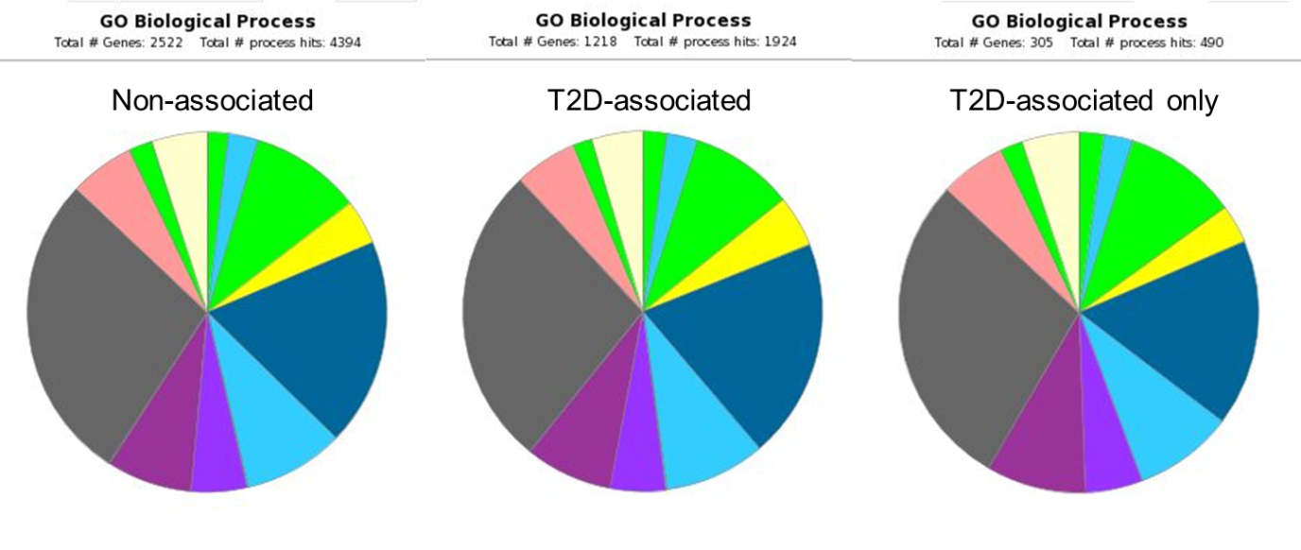
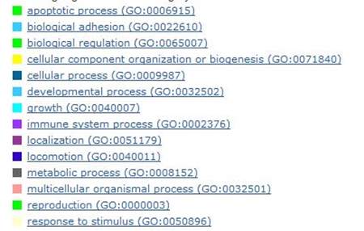
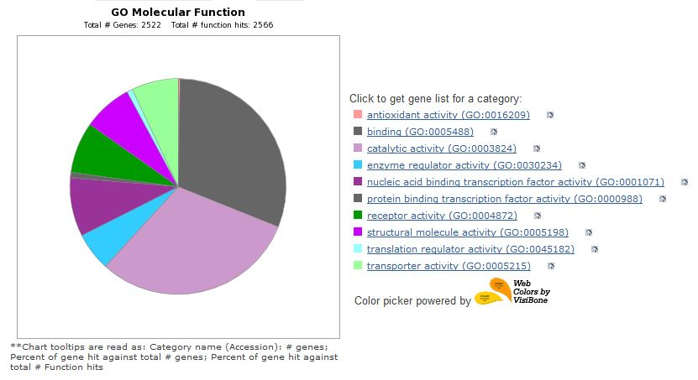
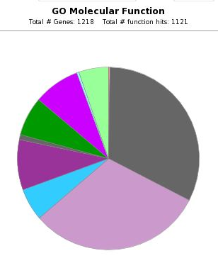
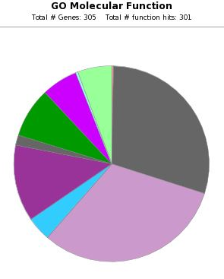
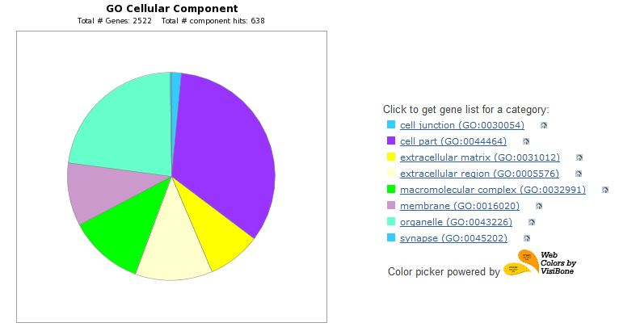
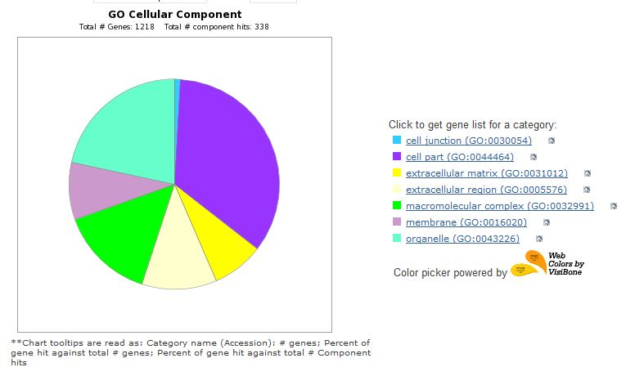
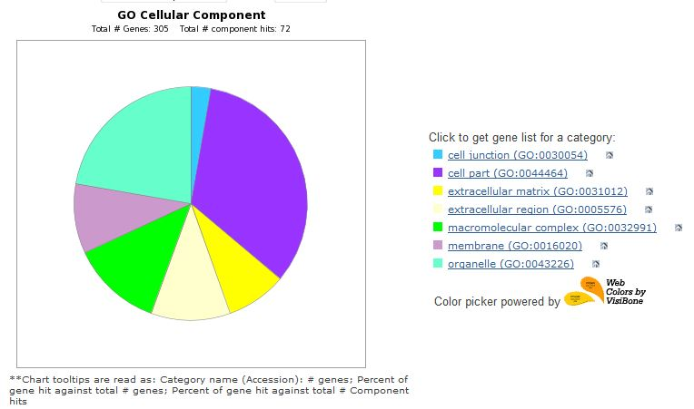
Distribution of GO terms similar between lists
Notes:
Here are some pie charts generated by PANTHER for my three gene lists for the three GO term categories (biological process, molecular function, and cellular component). Overall, the distribution of the genes into the subcategories was similar amongst all three lists.

Slide 12

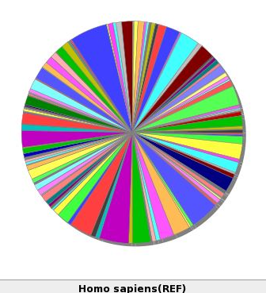
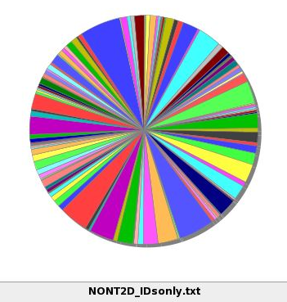
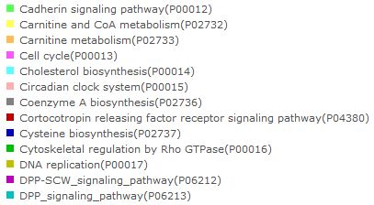
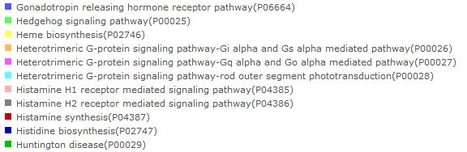
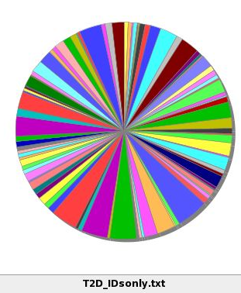
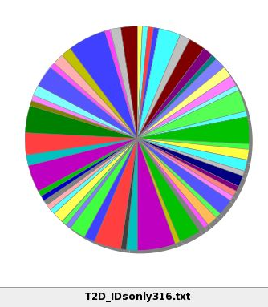
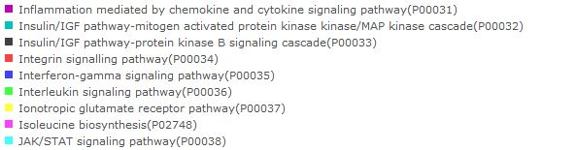
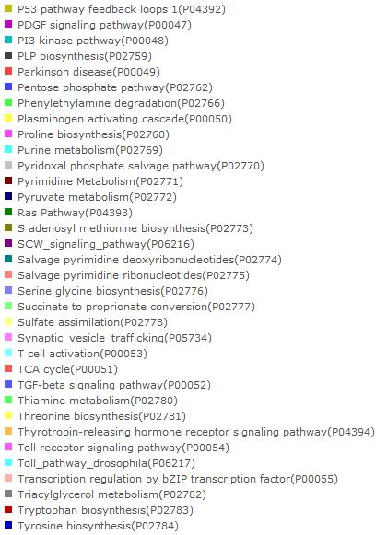
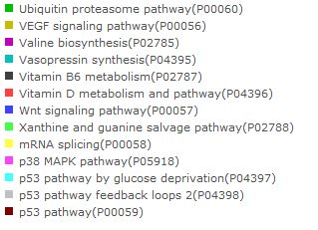
PANTHER Pathways
Human Reference
Non-associated
T2D-associated
T2D-associated only
Notes:
And there were similarities amongst the represented pathways assigned by PANTHER. Here I’ve included the legend for some of the larger pathway categories. The black arrows show the location of the pathway on the pie chart and the red arrows highlight two pathways that appeared enriched in the smaller T2D gene list. Obviously there were many signaling pathways associated with cancer in the gene list. Of particular interest, there were a few pathways somewhat related to what you might expect to see in diabetes such as inflammation and insulin signaling.

Slide 13
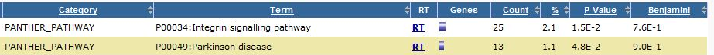
PANTHER Pathways
Non-associated
T2D-associated
T2D-associated only
Notes:
Here are the significant or almost significant pathways annotated for each gene list in Panther. The statistics are based on the prevalence of the pathway genes in you list compared to its abundance in the entire human genome.

Slide 14
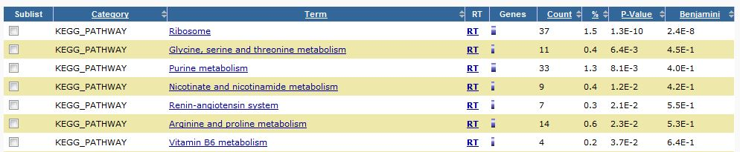
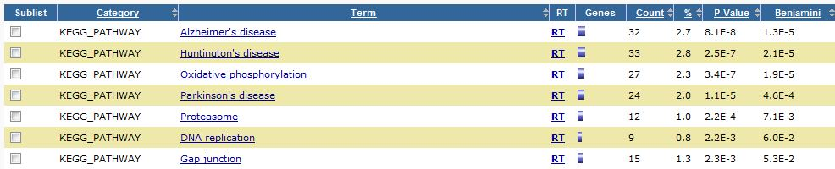
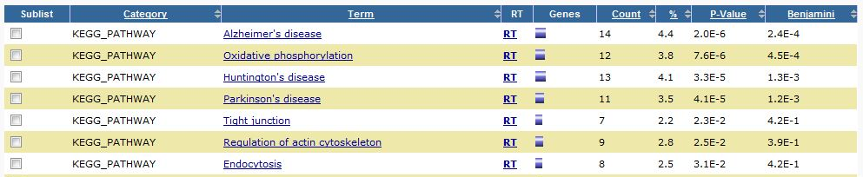
DAVID annotated KEGG pathways
Non-associated
T2D-associated
T2D-associated only
Notes:
DAVID has access to many pathway databases such as KEGG shown here. We see protein and metabolism terms for the non-associated cancers, and neurodegenerative diseases, energy production, and a few others in the diabetes-associated lists

Slide 15
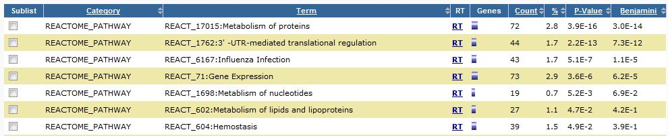
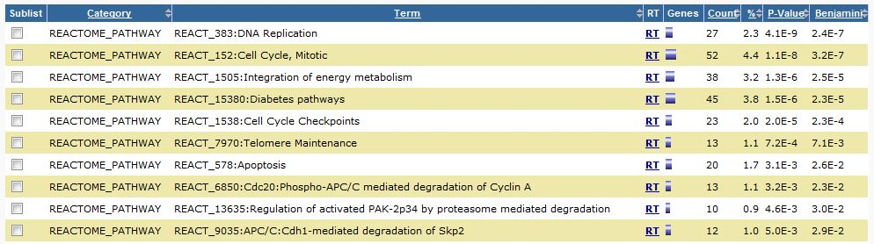
DAVID annotated Reactome pathways
Non-associated
T2D-associated
T2D-associated only
Notes:
Reactome is another database of biological pathways that DAVID has access to. Here again we see macromolecule metabolism in the non-risk list and cell cycle and energy production in the T2D associated list. Interestingly, Reactome actually annotated diabetes pathways to the lists and integration of energy metabolism

Slide 16
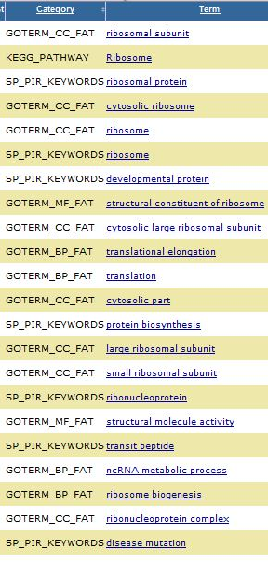
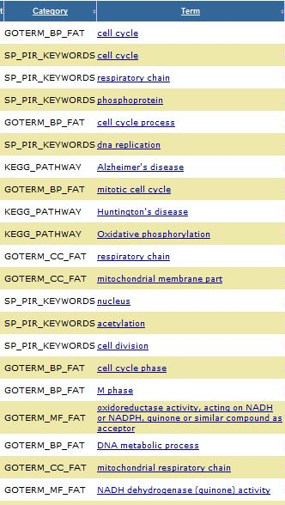
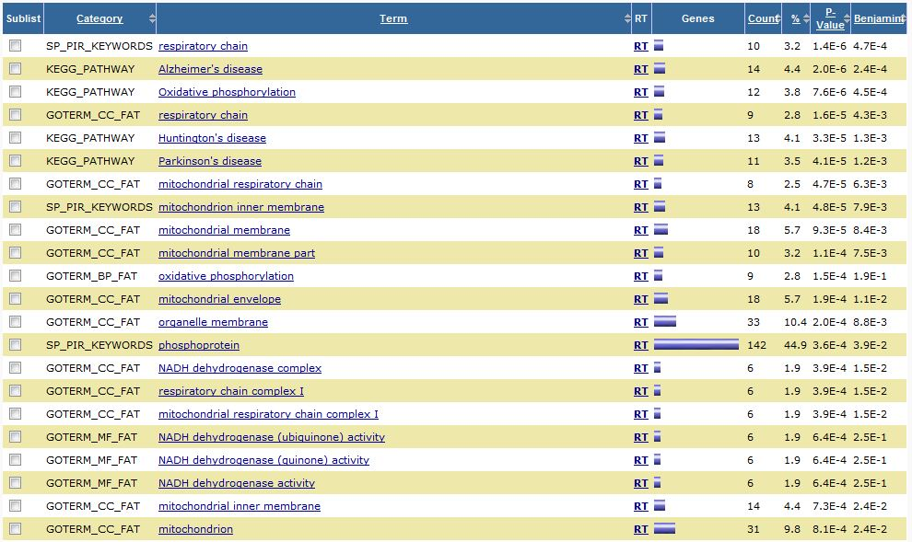
DAVID Annotated terms
Non-associated
T2D-associated
T2D-associated only
Notes:
Here is the top terms across all categories for each list annotated by DAVID. You can see a lot of macromolecule metabolism and biogenesis terms in the non-risk cancers, which you might expect since cancer generally needs to do a lot of in order to support its proliferation and growth. In the middle list we see many cell cycle terms, energy production terms, and neurodegenerative diseases. Similarly we see energy production, mitochondria, and cognitive diseases in the last smaller list. Cell cycle could be related to the cancer phenotype with uncontrolled growth. The energy production could be either related to cancer because cancers need a lot of energy or it could be related to the disrupted glucose metabolism in diabetes. Obese individuals and those with diabetes were found to have smaller mitochondria on average, which would be expected to impact energy production. Finally, diabetes has been observed to be a risk factor for cognitive dysfunction such as dementia and the listed diseases- Alzheimer’s, Huntington’s, and Parkinson’s diseases.

Slide 17
Conclusions
Non-risk cancer DE genes associated with metabolism and biogenesis of biological macromolecules
T2D-associated cancer DE genes related to cell cycle, energy production, inflammation, neurodegenerative diseases
Altered expression in pathways dysregulated in T2D patients
Cancer samples from patients with T2D or are these pathways commonly disrupted in the cancers and exacerbated by T2D?
Notes:
SO in conclusion it would appear that some genes differentially expressed in cancers that diabetic individuals are more susceptible to that are related to pathways disrupted in diabetic patients, such as inflammation and energy production. The non-risk cancers appeared to have differentially expressed genes related to other processes however, that gene list was much larger and as a result similarities with my T2D gene lists could have been missed. At this time it is possible that I got this result because the cancer samples were taken from individuals that also had diabetes or alternatively, this could hint that these particular pathways are normally disrupted in these particular cancer types and thus these tissue may be more susceptible to disruption by diabetes or greatly exacerbated by the condition. More cancers will need to be examined. A limitation of my project is that I did not consider the direction of change for the differential expression. This would have been interesting to see given some of the pathways that were identified.

Slide 18
Questions

